Slide 1

Notes:
As you can see in your bulletin this morning, we are continuing our sermon series on the core teachings of Jesus, which are found in what we call the Sermon on the Mount in Matthew chapters 5-7. And in today’s message, we come to the teaching of Jesus that ultimately led to my departure from the tradition of my upbringing, and, as it would turn out, a break from many evangelicals who prefer a warrior god over a crucified King.
It’s been about 20 years ago now that I read the Sermon on the Mount with fresh eyes and my American Christianity was challenged by Messiah Jesus. And I can still remember the question I was asked then, and I want to ask you, “What if Jesus really meant what he said?”
Remember, in Matthew 5, verse 17… [NEXT SLIDE]

Slide 2
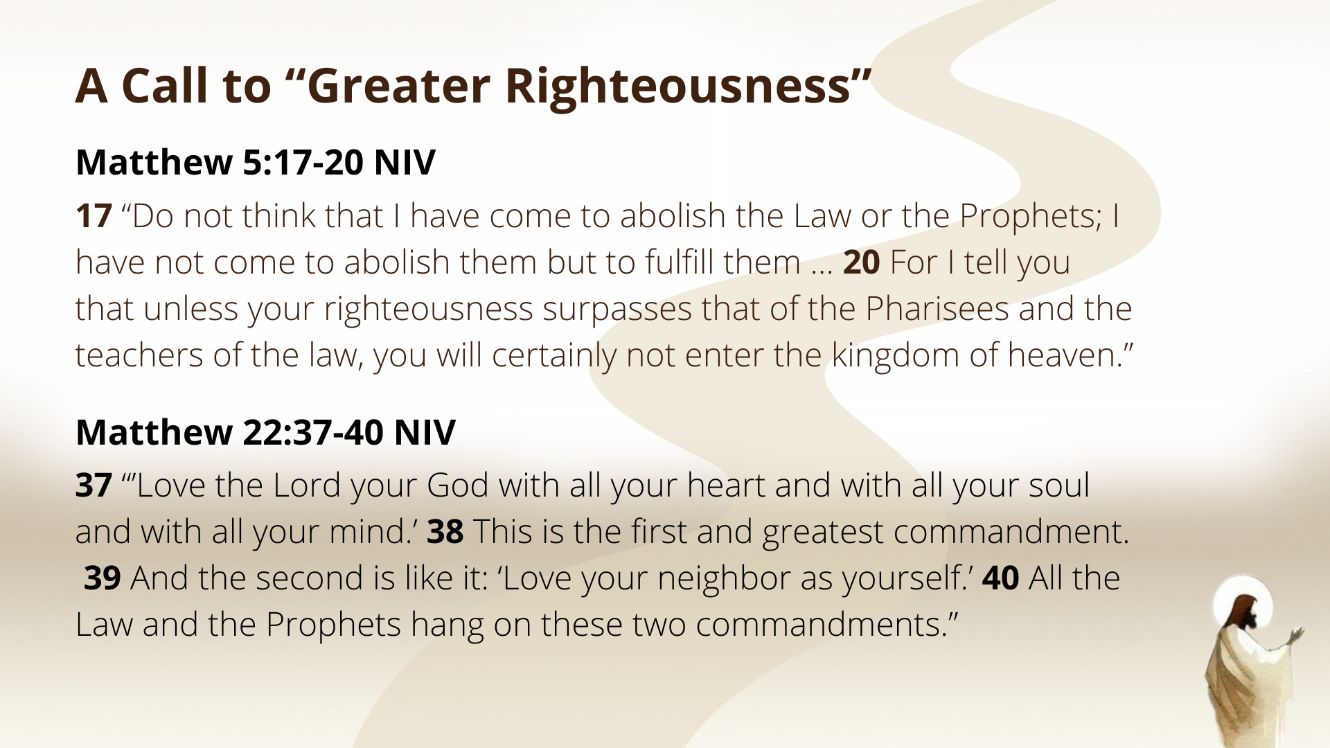
Notes:
[READ VERSE 17 & COMMENT]
In other words, Jesus is God’s full and final revelation. In John 5:39-40, Jesus said to the religious leaders: “You study the Scriptures diligently because you think that in them you have eternal life. These are the very Scriptures that testify about me, yet you refuse to come to me to have life.” Therefore, we must listen to Jesus. We can’t silence him, ignore him, contradict him, or jump over him to use the OT to justify anti-Jesus things.
For Jesus, his interpretations of Scripture and his commands are central and supreme for Jesus-followers, and, as we hear him say in Matt. 22:37-40, the way he lived is rooted in the love of God and neighbor—that was what motivated Jesus and his idea of righteousness.
It’s important to remember that this morning as we hear how Jesus addresses the final two case studies in the Law—revealing God’s deeper wisdom from the Torah as it relates to retaliation against our enemies, everyone’s dignity and worth as people made in God’s image, and nonviolent resistance to injustice.
Which is the focus of the ninth message in our series… [NEXT SLIDE]

Slide 3

Notes:
Non-Retaliation and Enemy Love.
There is a lot to cover today: (1) because we’ll be looking at the last two of Jesus’ interpretations of the Law; and (2) there’s some serious unpacking to do with Jesus’ words, if we’re going to understand them correctly. So, I’ll mainly be focusing on Jesus’ context and his meaning and then invite you to prayerfully explore all its implications as a disciple who desires to apply his teaching and faithfully follow him.
And of course, as always, I welcome your questions after this message as you wrestle with what may arguably be the most challenging teaching in the Sermon on the Mount.
With that said, please turn with me to Matthew chapter 5… [NEXT SLIDE]

Slide 4
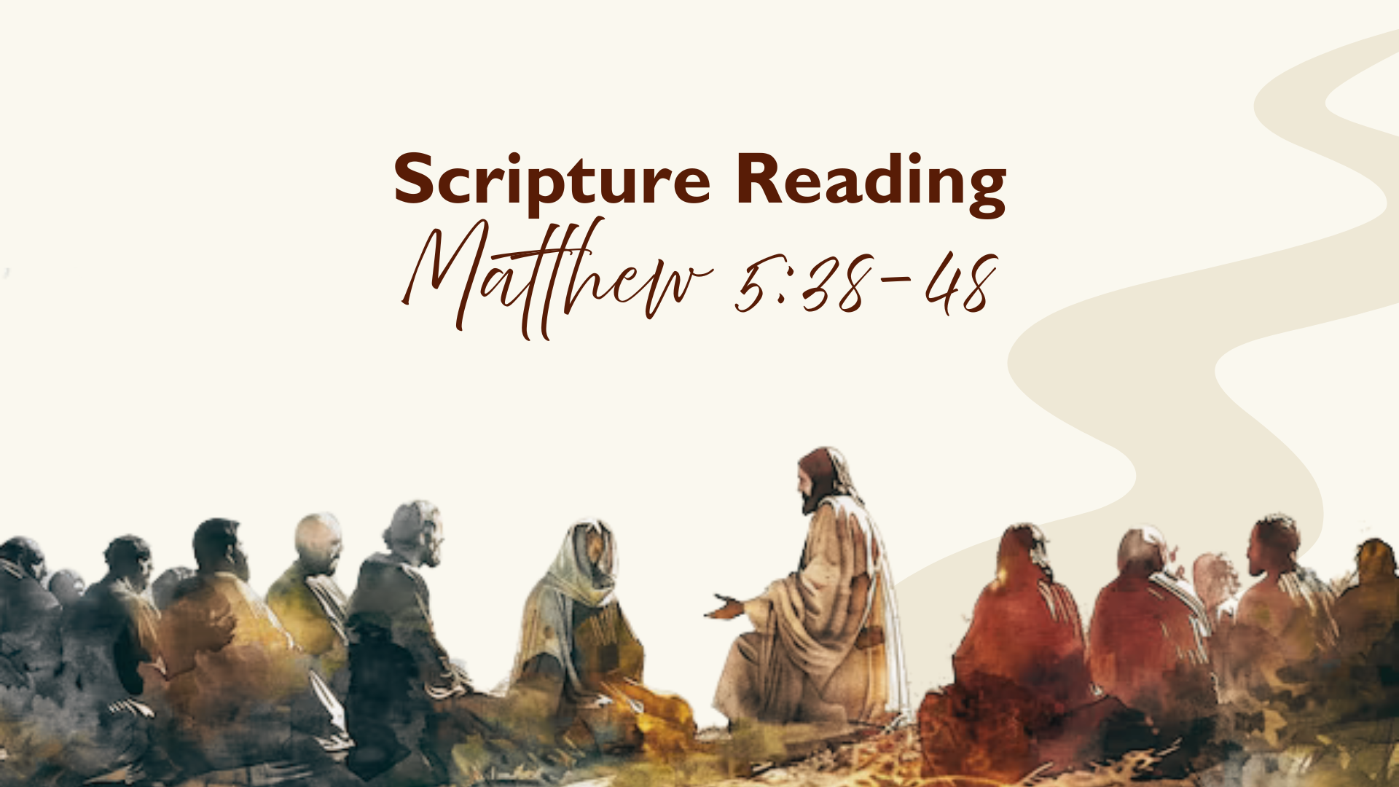
Notes:
[INVITE PEOPLE TO STAND & READ MATTHEW 5:38-48 NIV]
On the morning of October 2, 2006, a gunman entered a one-room Amish schoolhouse in Nickel Mines, PA, and opened fire, killing five young girls before taking his own life. This horrific tragedy shook the nation—but what happened next stunned the watching world even more. Within hours, members of the Amish community visited the gunman’s widow and parents. They didn’t come in anger or to demand justice—they came to forgive. They brought food, comfort, and tears. They told her they bore no grudge and that they were praying for her family too. At the funeral for the shooter, more Amish than non-Amish attended. And one father who lost his daughter said, “In our hearts, we have to forgive, because that’s what Jesus taught us to do.” And that quiet act of forgiveness—so simple, so costly—became a living picture of the gospel. They refused revenge. They chose love over hate. And in doing so, they showed us what it means to be children of the Father in heaven.
My friends, when Jesus said, ‘Do not resist an evil person” and “love your enemies and pray for those who persecute you,” He wasn’t giving us an impossible ideal—He was showing us what it looks like when God’s love rules a human heart. Therefore, let’s listen again to the words of Jesus as we go verse-by-verse through the passage, and ask ourselves, “What if Jesus really meant what he said?” And then a second question, “What would it look like for me to love like that?” Matthew 5, verse 38… [NEXT SLIDE]

Slide 5

Notes:
[READ VERSE 38 & COMMENT]
v. 38 – “eye for eye, and tooth for tooth” - What is Jesus referencing here?
He’s actually referring to several verses in the Law of Moses… [NEXT SLIDE]

Slide 6
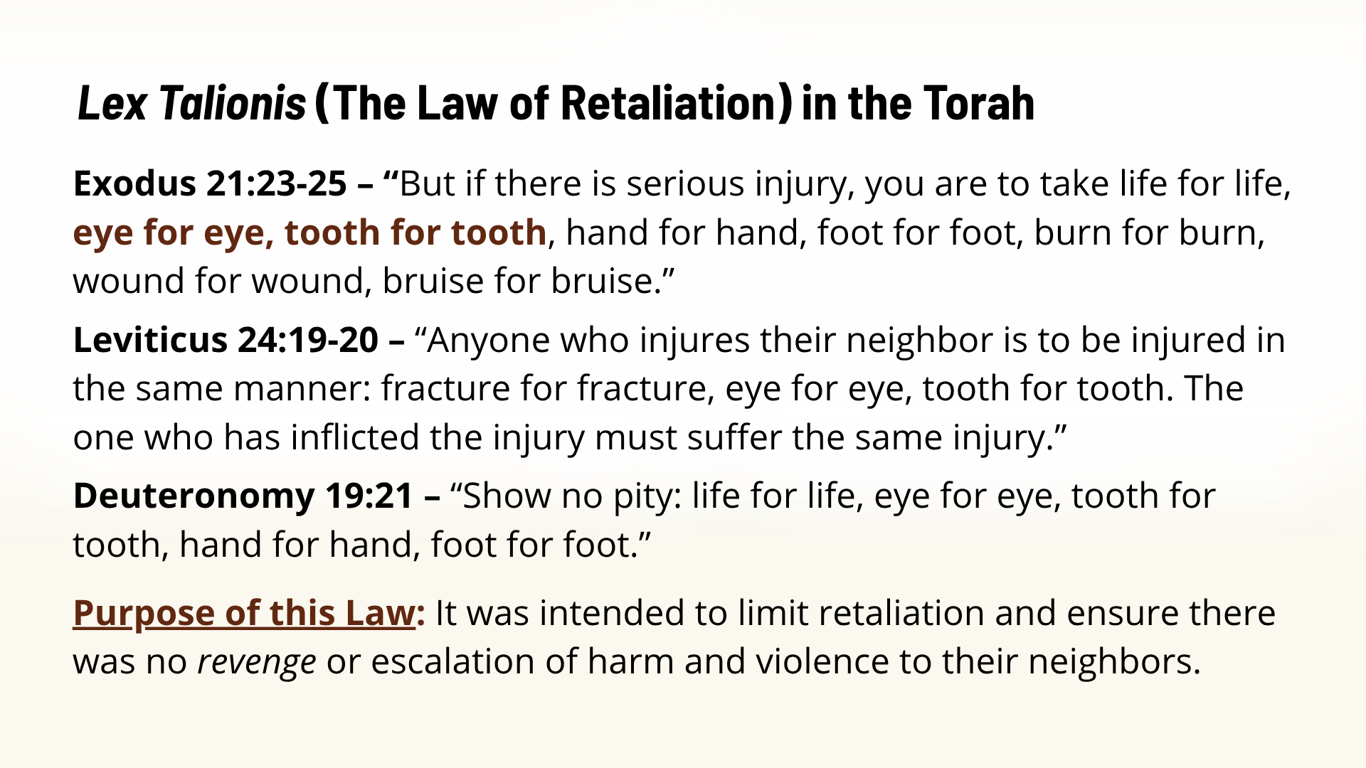
Notes:
It’s known in Latin as lex talionis or the law of retaliation. Beginning with Exodus 21:23-25, God gave the Israelites a law that was originally intended to limit retaliation and ensure that people wouldn’t take revenge or escalate harm and violence to their neighbors. Because, unfortunately, that is often our fallen human impulse.
We can certainly see the need for this after reading Genesis 34—when Jacob’s daughter, Dinah, is sexually assaulted by a local prince, he wants to keep the peace between their tribes by marrying her; and so, Dinah’s brothers, led by Simeon and Levi, pretend to make a deal that if all the men of their tribe will circumcise themselves and worship Yahweh, then all will be well. But what do they do? Three days later when their enemies are in pain, they kill them. The rest of Jacob's sons then plundered the city, taking their wealth, women, and children as captives. So, yeah, that whole “eye for eye” thing was necessary to limit retaliation.
Now, in Jesus’ day, the law of retaliation usually meant some sort of monetary compensation or fine for the harm caused. And the punishment needed to fit the crime. For example, if you break your neighbor’s arm, you’re going to pay his bill, at the very least. But while the law curbs the escalation of harmful retaliation… notice… it doesn’t create peace between parties. And since Jesus’ aim is peacemaking, he takes the wisdom of this law to a new level.
Verse 39… [NEXT SLIDE]

Slide 7
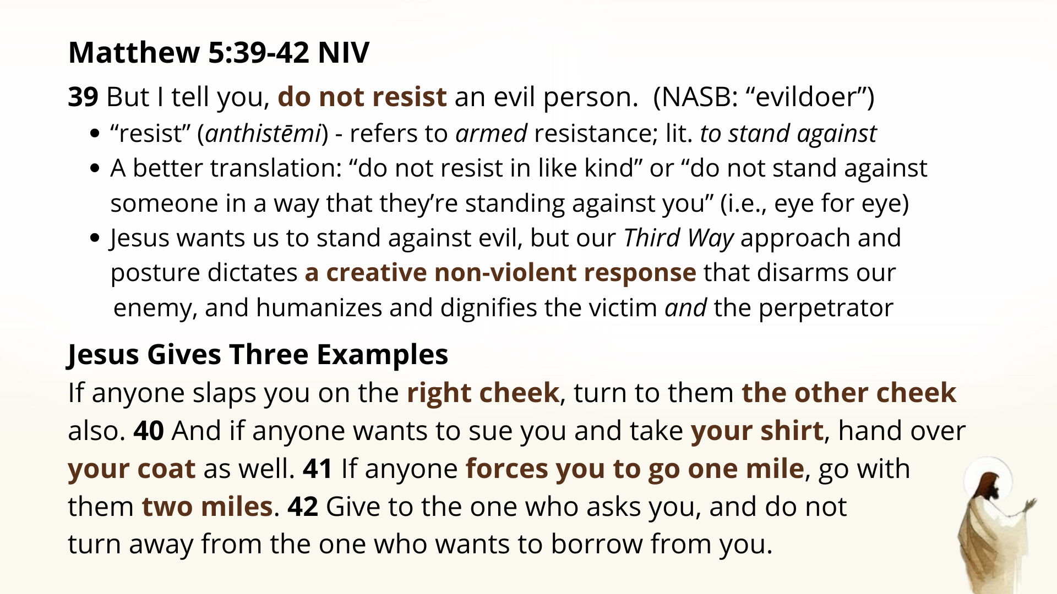
Notes:
[READ & COMMENT ON VERSE 39 FROM SLIDE]
[READ 39b-42 & COMMENT] – we can’t take this at face value
v. 39b – backhanded slap to insult, shame, and dishonor (a fist takes a person out); this is an attack on a person’s dignity (“I’m better than you”); offering the other cheek requires them to slap you again with an open hand and treat you as an equal; resistance, but not in kind
v. 40 – tunic or shirt is a garment on the skin; the coat is heavier, made of wool, and used to cover up at night; in the Law, if someone owes you money they can take your coat during the day but have to give it back at night; but this person isn’t trying to take your coat, they are trying to skirt the Law and go after your shirt; and Jesus is telling us to draw attention to the injustice by this shocking action; let people see how evil the perpetrators actions are; and notice, you are allowing yourself to suffer in order to expose the evil and injustice
v. 41 – Roman soldiers can force someone to carry their gear a mile, but no further; the same phrase is used with Simon of Cyrene; so, Jesus is saying, they can treat you like a pack animal for one mile, but then you have the opportunity to assert your own humanity, dignity, and worth by showing generosity; this act of love exposes injustice and also has the potential to make an enemy a friend—What kinds of creative acts of justice can do that today? Because Jesus is not telling us to be doormats for people to walk all over us. But rather, he is inviting us to take up our cross and engage in creative non-violent resistance.
v. 42 – these three examples illustrate a kingdom ethic of outrageous generosity and a refusal to perpetuate harm, because evil and hate can only multiply evil and hate
The Apostle Paul makes this clear when he says this… [NEXT SLIDE]

Slide 8
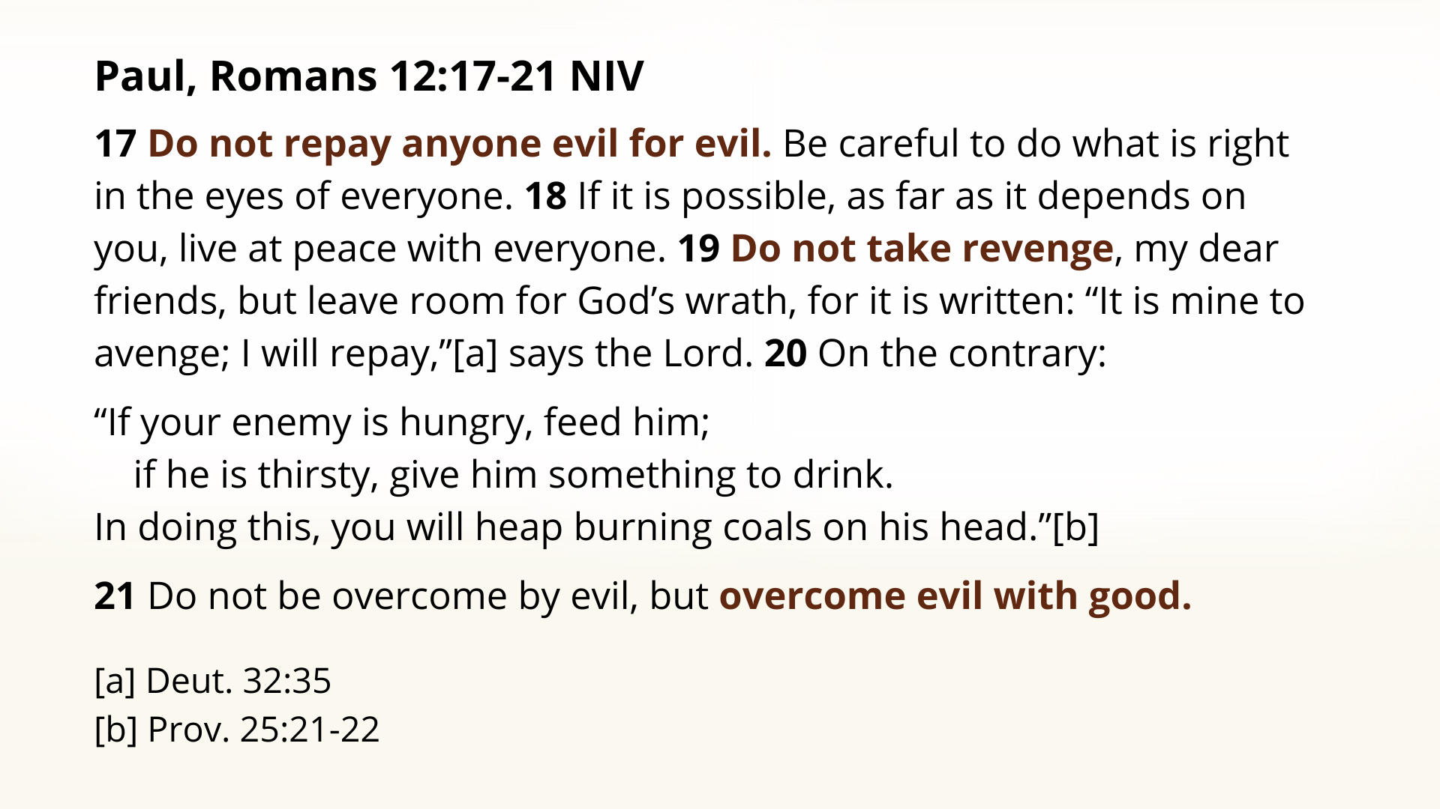
Notes:
[READ PASSAGE & COMMENT]
v. 20 - “burning coals” were symbolic of deep remorse. Isaiah 6, the prophet uses coal to cleanse his lips. In the ANE, they use “coals” language to describe the pain of shame that can open people’s eyes to the problem. So, the idea is this: Do good to your enemy → you awaken his or her conscience → and they are then convicted of the wrong committed.
v. 21 – This requires a trust in God’s all-knowing, all-seeing justice over your own, e.g., 1 Samuel 24 – David spares Saul; “May the Lord judge between you and me, but my hand will not touch you.” Instead of retaliation, David chose restraint. Instead of vengeance, he chose trust in God’s justice. It was a moment that revealed a heart after God’s own heart — a heart that refuses to return evil for evil. David’s choice that day points forward to a greater King — one who would not strike back when struck, who would pray for His enemies as they nailed Him to a cross. In the Sermon on the Mount, Jesus is calling us into that same radical love.
And did you know that these are the teachings that influenced… [NEXT SLIDE]

Slide 9
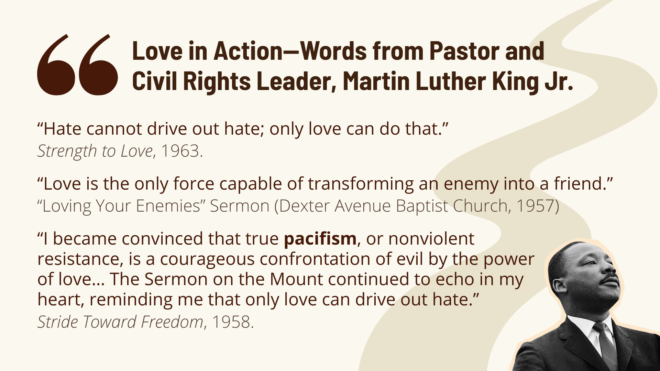
Notes:
The reverend Martin Luther King, Jr.
[READ QUOTES & COMMENT]
Pacifism: comes from the Latin pax facere, which means ”to make peace”
When I was on the Civil Rights bus tour a few years ago, I was reminded that King had a list called, “The Ten Commandments of Nonviolence.” You can look this up. He required volunteers to sign this before participating in direct action during the 1963 Birmingham Campaign. And you’ll notice that: (1) King intentionally grounds the entire nonviolence method in Jesus himself; (2) violence isn’t just physical; verbal violence and heart-level hatred also break these ethical guidelines; and (3) the goal is not to “win” but to reconcile. That’s the aim of Jesus and the logic of the Kingdom of God. Clearly, this is part of what makes King’s nonviolence distinctively ”Christian” nonviolence, not simply Gandhian moral philosophy.
If you’re interested in rethinking violence and exploring this further… [NEXT SLIDE]

Slide 10

Notes:
The books on the screen are a good place to start:
Fight: A Christian Case for Non-Violence by Preston Sprinkle
A Field Guide to Christian Non-Violence by David Cramer and Myles Werntz
If Jesus is Lord: Loving Our Enemies in an Age of Violence by Ronald Sider
Kingdom Ethics: Following Jesus in Contemporary Context by David Gushee & Glen Stassen
Back to our main Scripture Reading… Matthew chapter 5, verse 43… [NEXT SLIDE]

Slide 11

Notes:
[READ MATTHEW 5:43]
What command is Jesus referring to here?
Well, he’s partially quoting from Leviticus… [NEXT SLIDE]

Slide 12
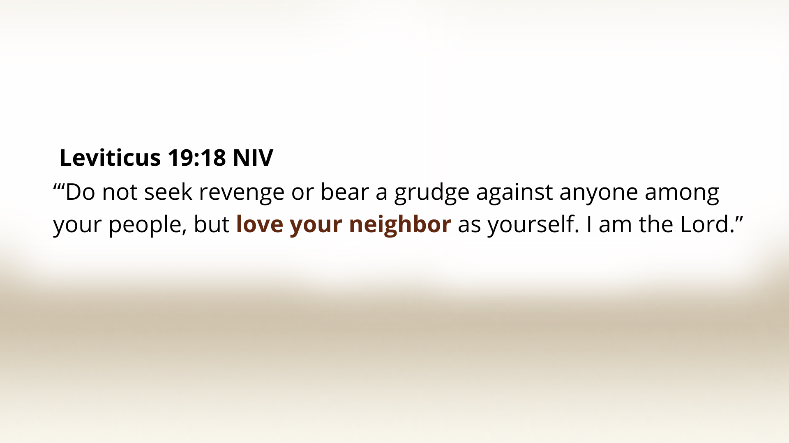
Notes:
[READ VERSE & COMMENT]
But what about “hate your enemy”? Where is that coming from? Well, there is no law in the Torah that says that. It seems like Jesus is including in this command a popular interpretation of Leviticus 19:18, which was to interpret “neighbor” to be your fellow Israelite. And so, if I’m only to love my fellow Israelite neighbor, well, then, I must be free to hate my enemy. You will recall that Jesus was once asked the question in Luke 10, “Who is my neighbor?”; and then he answers with what is known as the Parable of the Good Samaritan.
Back to our text… listen to how Jesus challenges this popular interpretation with these words in verse 44… “But I tell you, love your enemies and pray for those who persecute you…” And who are the enemies that would have immediately come into the minds of Jesus’ original audience? Well, there is a clue here, as Jesus has already referenced a humiliating Roman law—carrying a soldier’s gear and then going the extra mile. Therefore, the Romans would be first and foremost the real enemy of a faithful, law-abiding Jew.
Consider a few reasons why that would be the case… [NEXT SLIDE]

Slide 13
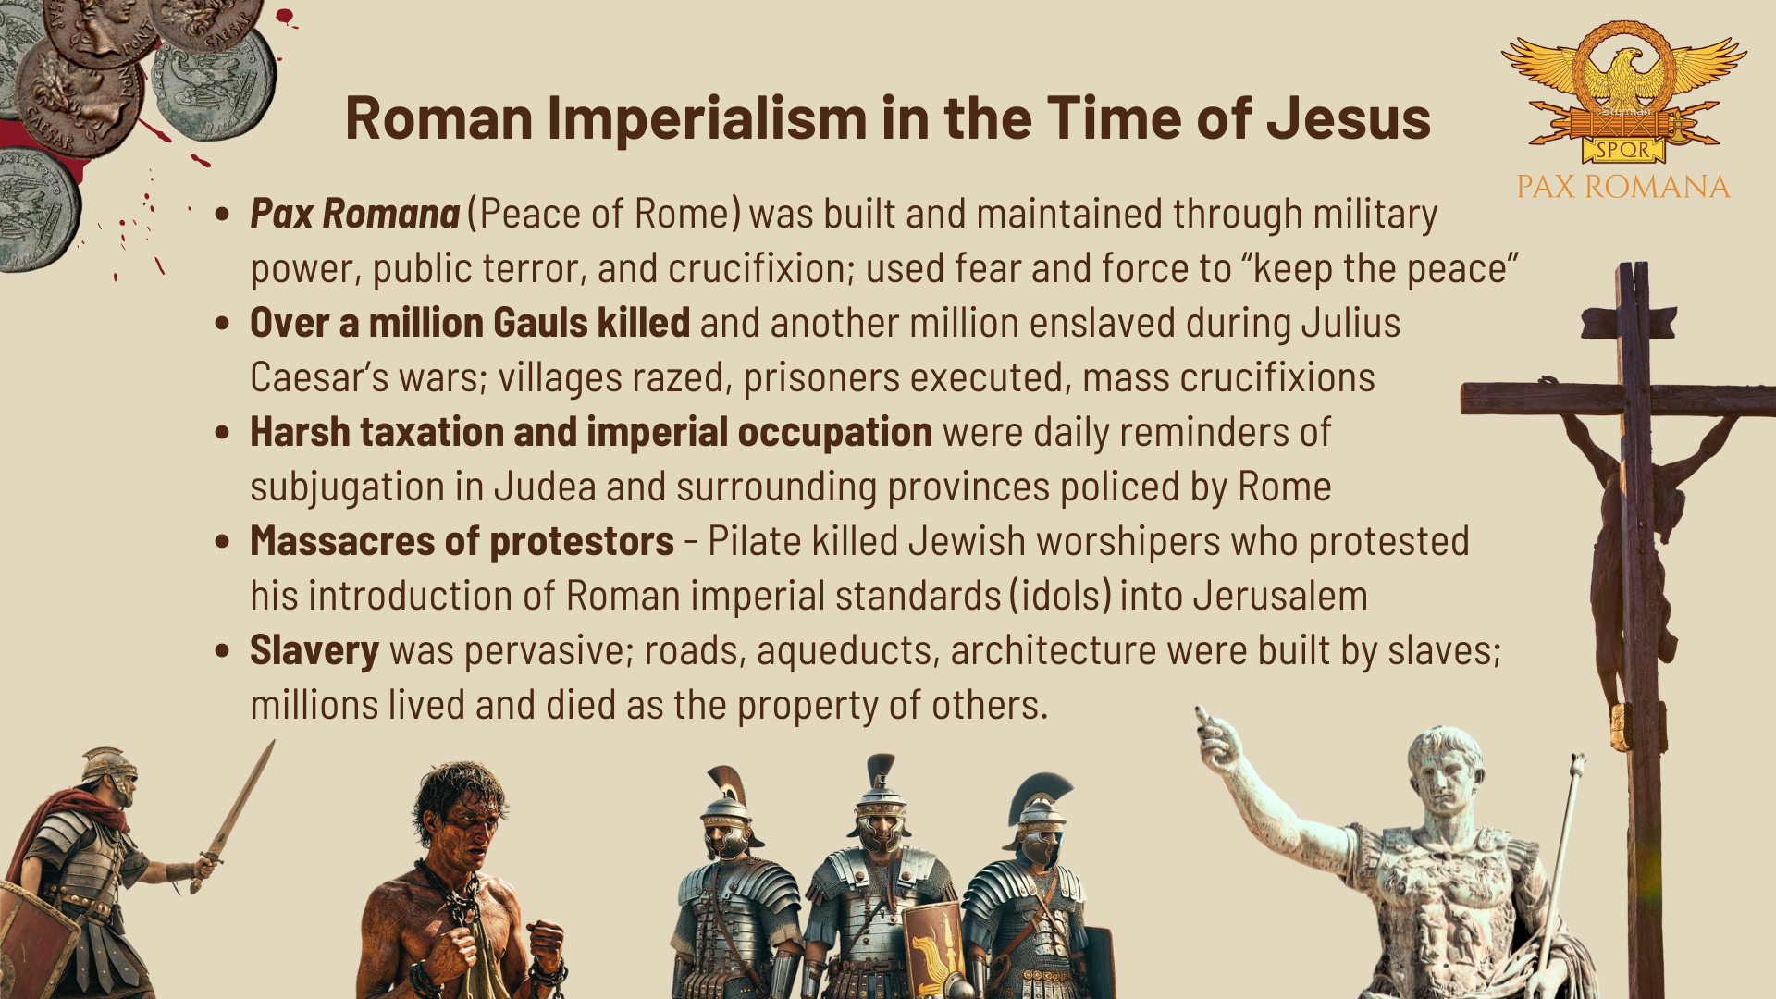
Notes:
[READ & COMMENT ON SLIDE]
And so, Jesus is calling his first century listeners to love real, demon-worshiping, genocide-committing physical enemies. That would have been (and still is) a scandalous thing to say.
And think back to Jesus’ situation and context, particularly the various religious and political groups in his day who all had strong feelings about the Romans… [NEXT SLIDE]

Slide 14
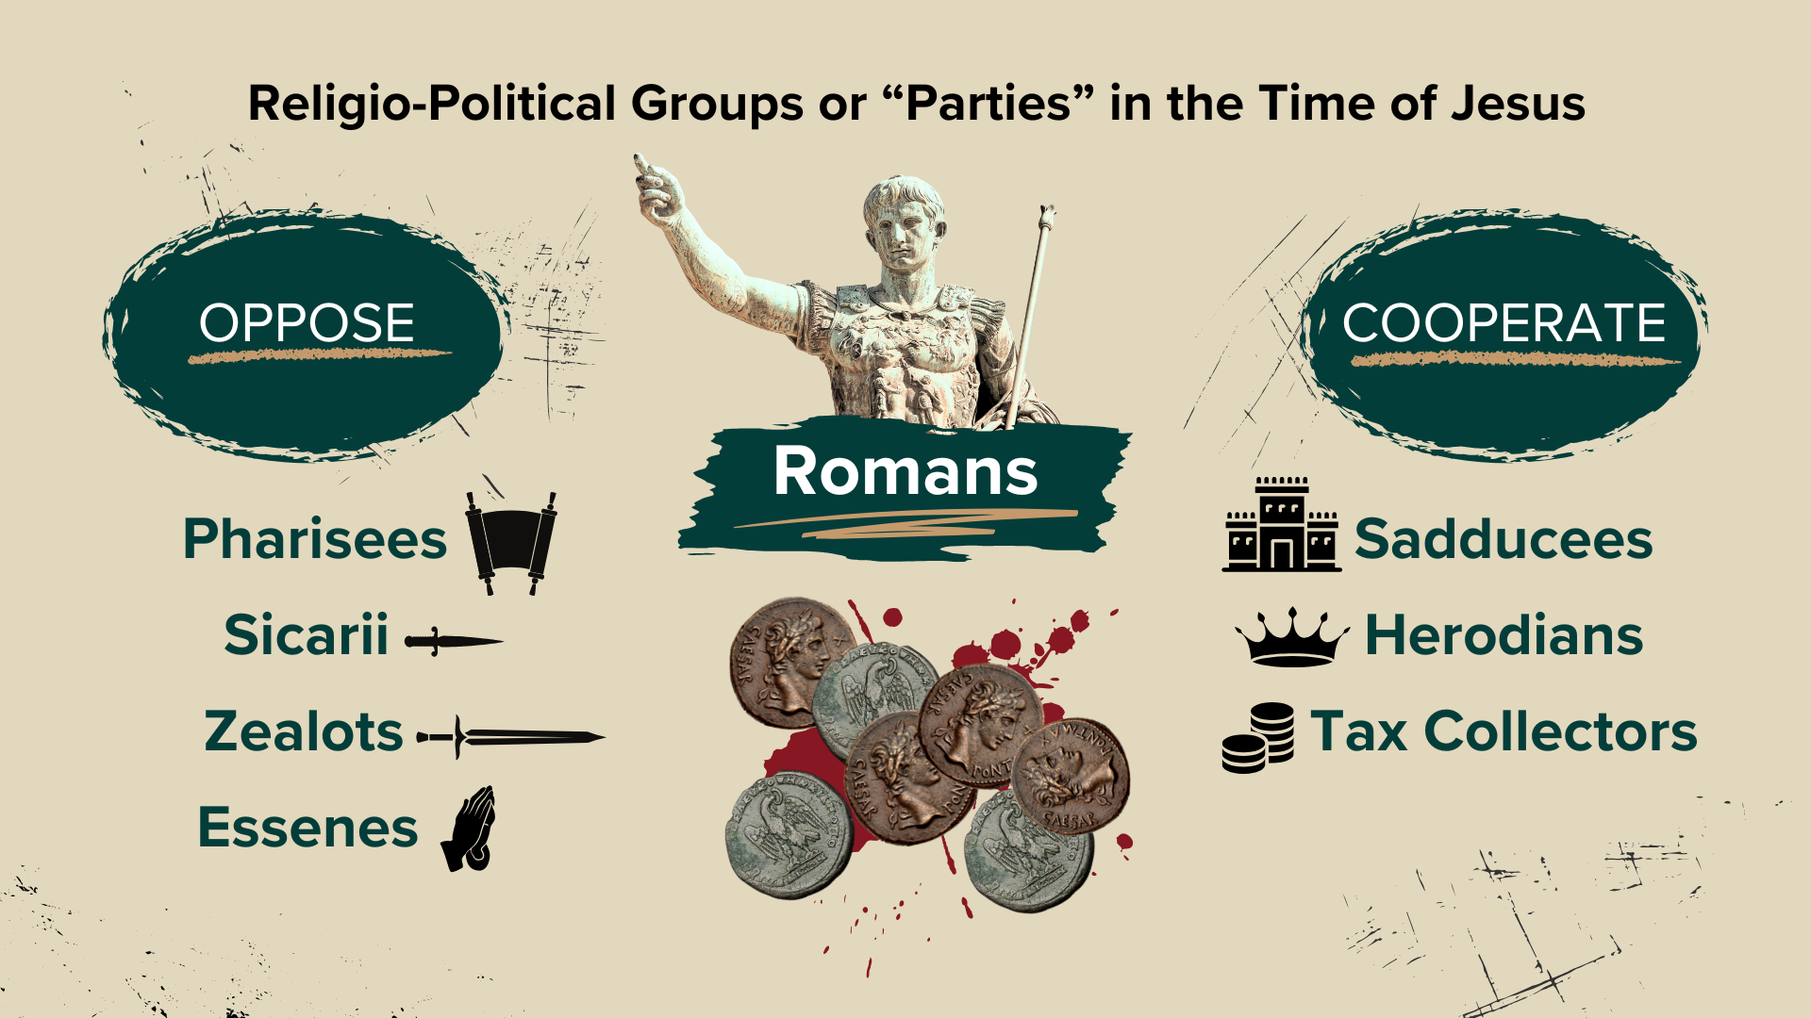
Notes:
Some groups like the Sadducees, Herodians, and Tax Collectors cozied up to the powers that be and sought to cooperate and benefit from the Roman empire. But most Jews opposed the Romans. And all of them believed in violence to some degree. The Sicarii and Zealots were actively using violence to assassinate their enemies, hoping that a Messiah would come along and crush their enemies. And the Pharisees and monastic Essenes believed in violence, but that obedience to Torah, holiness, and prayer was in order… until the Messiah comes, organizes the people of Israel, and then violently revolts against the Romans.
Remember, the Jews cherished the Scriptures that (on its surface) depicted the Messiah being a warrior-king who would destroy their enemies (e.g. Deut. 7:1-4; Deut. 25:17-19; Psalm 139:19-22; Isa 13:1-9, etc.). So, it was a significant obstacle to them (among other things Jesus taught) to see and hear Jesus paint a very different portrait of God and his Messiah.
Let’s look at the final five verses… starting again with verse 44… [NEXT SLIDE]

Slide 15
Notes:
[READ MATTHEW 5:44-48 & COMMENT]
v. 44 – praying for our enemies will turn our hearts away from hate and allow us to see them the way God sees them; evildoers, no doubt, but except for God’s grace, we too can be led astray by our flesh and by sin, death, and the devil. So, if you’re struggling to love your enemies, Jesus says to try praying for them. And then you’ll start to see with his eyes.
v. 45 – this kind of love reflects the Father’s own character, and those who choose to embody that love show they are his kids. Scott McKnight writes. “To love enemies is to mirror God’s own generous and indiscriminate love—it’s the hallmark of those who truly belong to Him.”
v. 46-47 – Jesus is inviting us into a love that transcends self and your tribe
v. 48 – “perfect” is a terrible English translation; it means to be whole, mature, or complete
And so, don’t miss this: What sort of Messiah is Jesus revealing himself to be? [NEXT SLIDE]

Slide 16
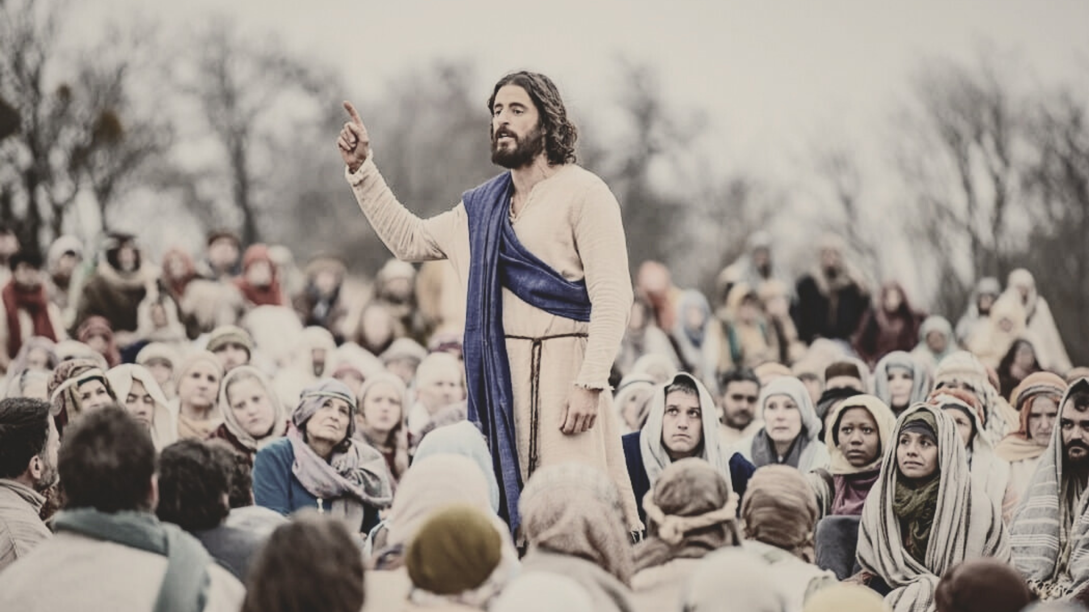
Notes:
First, Jesus reveals that violence is not the way of the Kingdom. He said, ”If you live by the sword, you will die by the sword.” He showed us that he is a warrior, but in a totally different sense. This is the Jesus that took on the devil and cast demons out of people. 1 John 3:8 says, “The reason the Son of God appeared was to destroy the devil’s work.” Paul said, the real fight is “not against other human beings, but against the rulers, against the authorities, against the powers of this dark world and against the spiritual forces of evil in the unseen realms” (Eph.6:12)—the real spiritual battle against Satan (which we see in Jesus’ temptations, in his exorcisms, and healings) and it’s for the souls of human beings.
And you can’t overcome sin and spiritual evil with a sword or a gun, nor by violent thoughts or speech. Rather, Jesus shows us that we ultimately win by serving, sacrificing, suffering, and dying (if need be), but never by killing. Remember, he told Peter to put away his sword, for we follow a crucified King and his upside-down Kingdom. And, my friends, when Jesus disarmed Peter, he disarmed us all. But we are not left alone or without a way to resist or defend ourselves. Because we have been given the Spirit and we’re being invited to walk the narrow path of Jesus, as we resist in love, fight with faith, and trust in the Lord.
Some of you know this story from the life of Corrie ten Boom… [NEXT SLIDE]

Slide 17
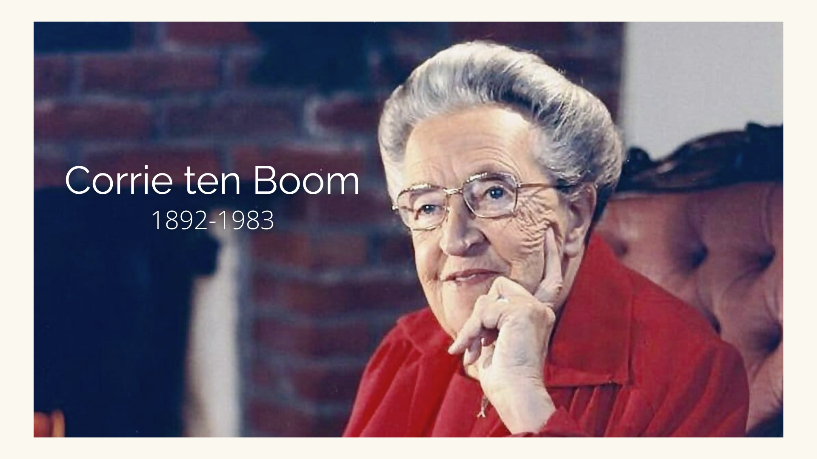
Notes:
After surviving the horrors of a Nazi concentration camp, Corrie ten Boom traveled the world speaking about forgiveness and reconciliation. One night, after sharing her testimony in Germany, a man approached her and she instantly recognized him. He had been one of the guards at Ravensbrück, the camp where her sister Betsie had died. He told her, “I’ve become a Christian. I know that God has forgiven me for the cruel things I did, but I would like to hear it from your lips. Will you forgive me?”
Corrie froze. Memories flooded back — the humiliation, the suffering, the death of her sister. Her hand refused to move. But she prayed silently, “Jesus, help me. I can lift my hand; You supply the feeling.” She reached out. And as she did, she said she felt a current pass from her shoulder down her arm into their joined hands. Tears filled her eyes as she said, “I forgive you, brother… with all my heart.” “For a long moment we grasped each other’s hands,” she later wrote, “the former guard and the former prisoner. I had never known God’s love so intensely as I did then.”
Brothers and sisters,, that’s what the kingdom of God looks like. When Jesus says, ‘Love your enemies and pray for those who persecute you,’ He isn’t calling us to something sentimental; he’s inviting us to embody the agape love of God… which the Spirit can empower us to do once we’ve surrendered to the will of God in Christ and ask him to help us. Therefore, as disciples of Jesus, let us make up our minds that this is the way of our Lord and pray that he will help us to love as he loves, so that the world will know that we belong to him.
Finally, here are some questions to help us reflect and respond together… [NEXT SLIDE]

Slide 18
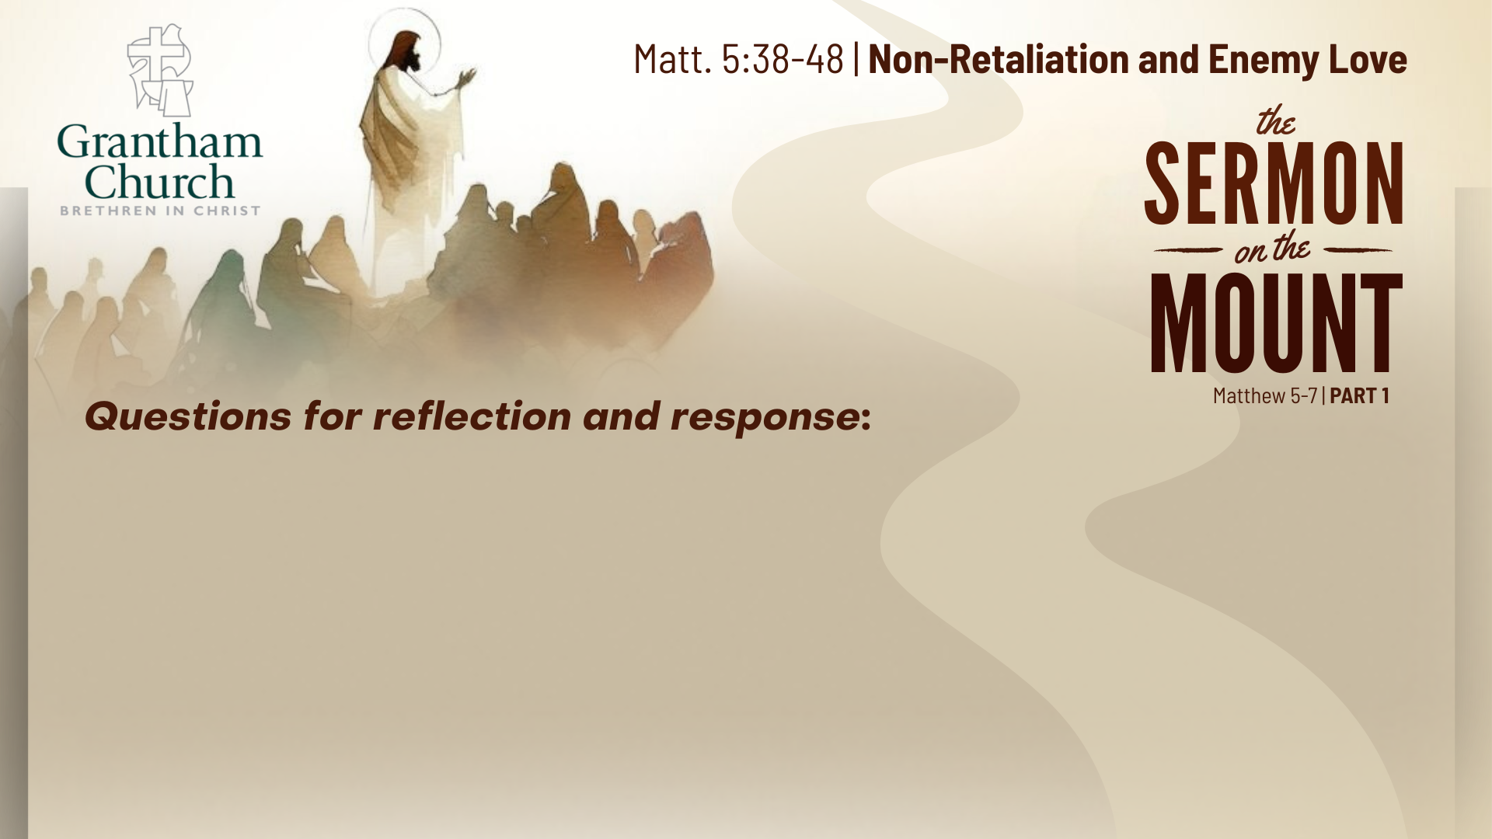

Slide 19
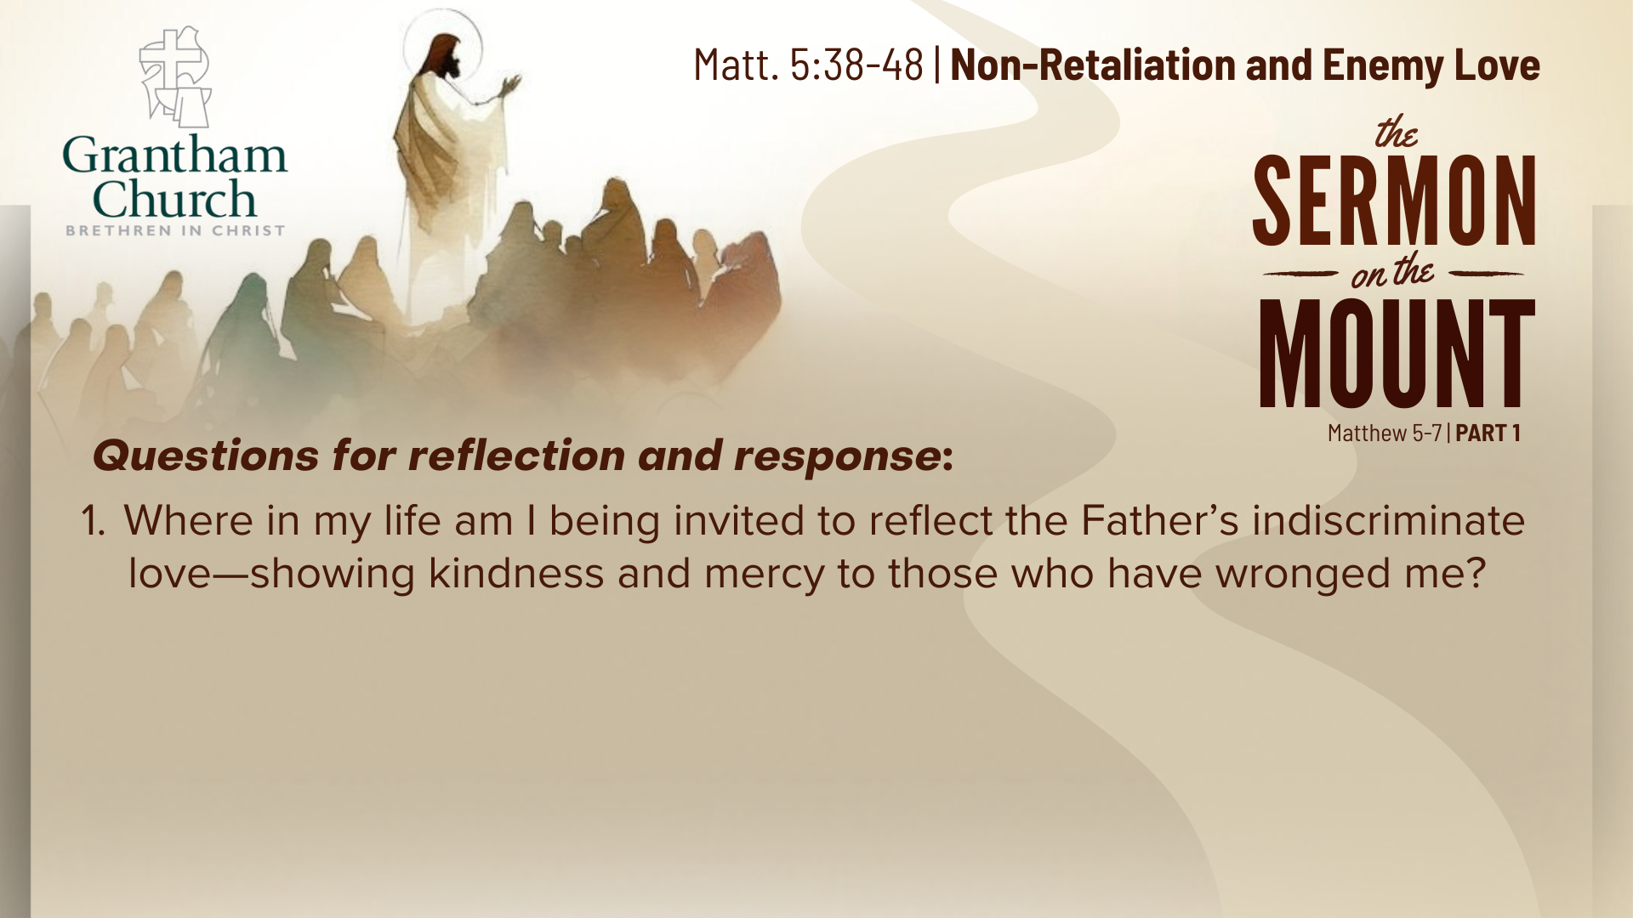

Slide 20
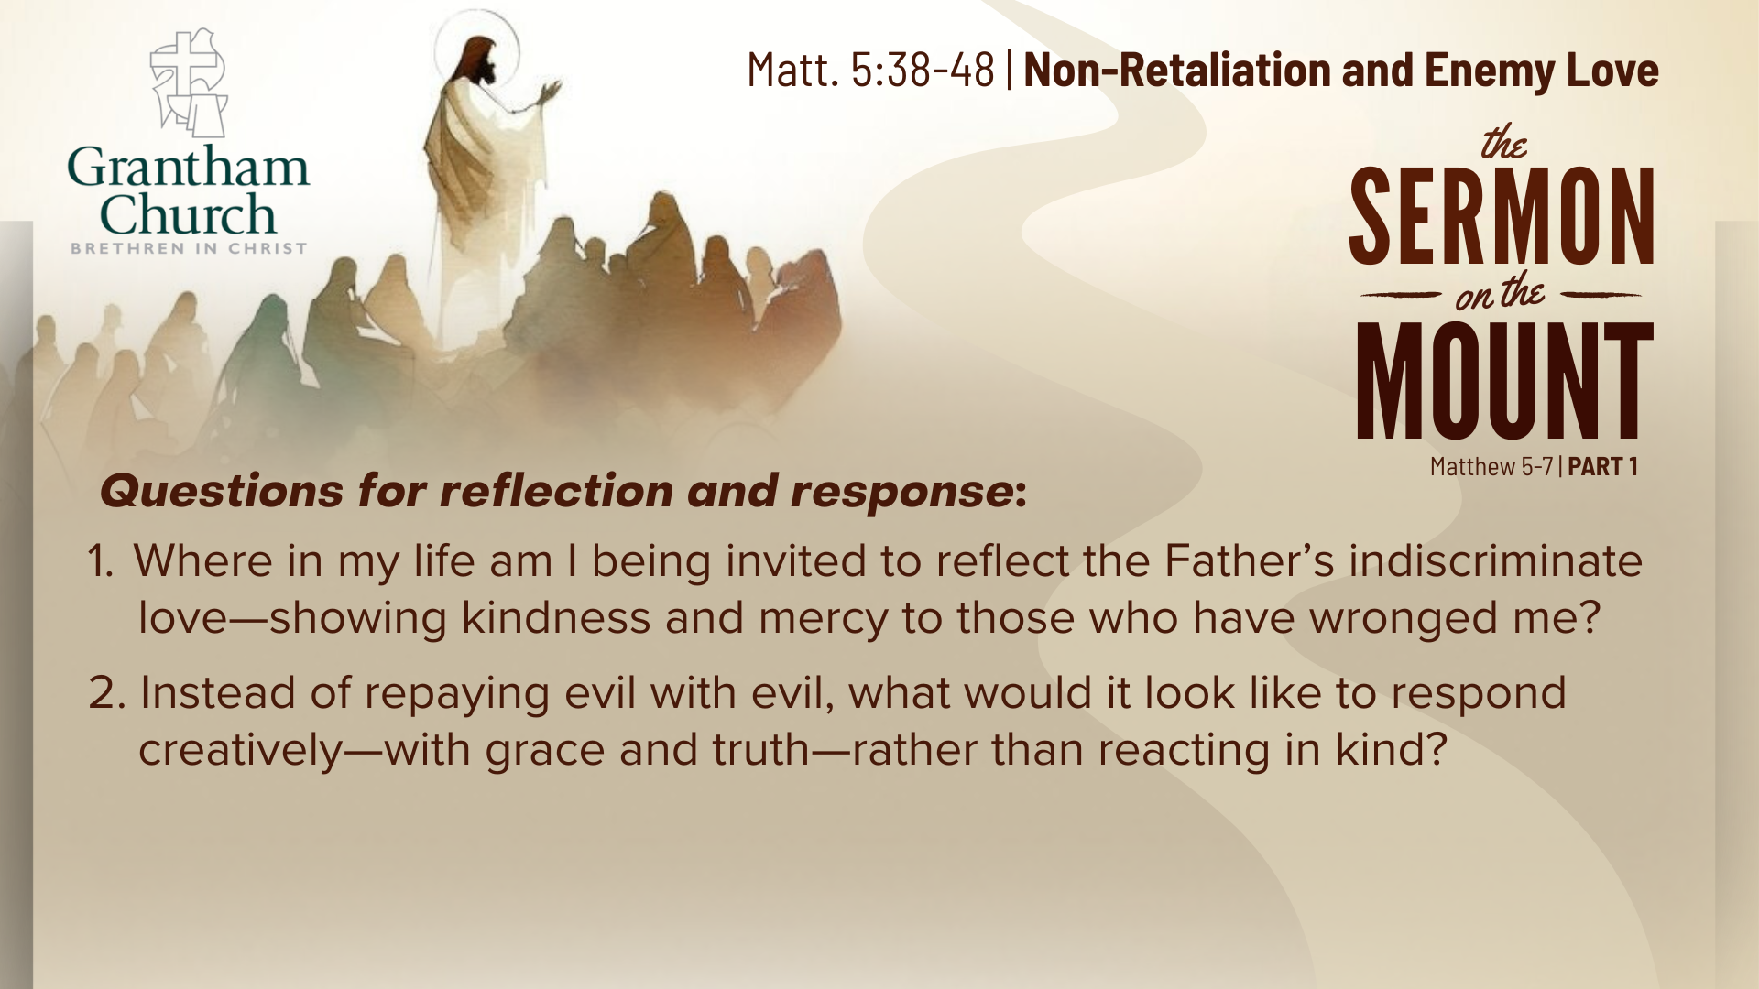

Slide 21
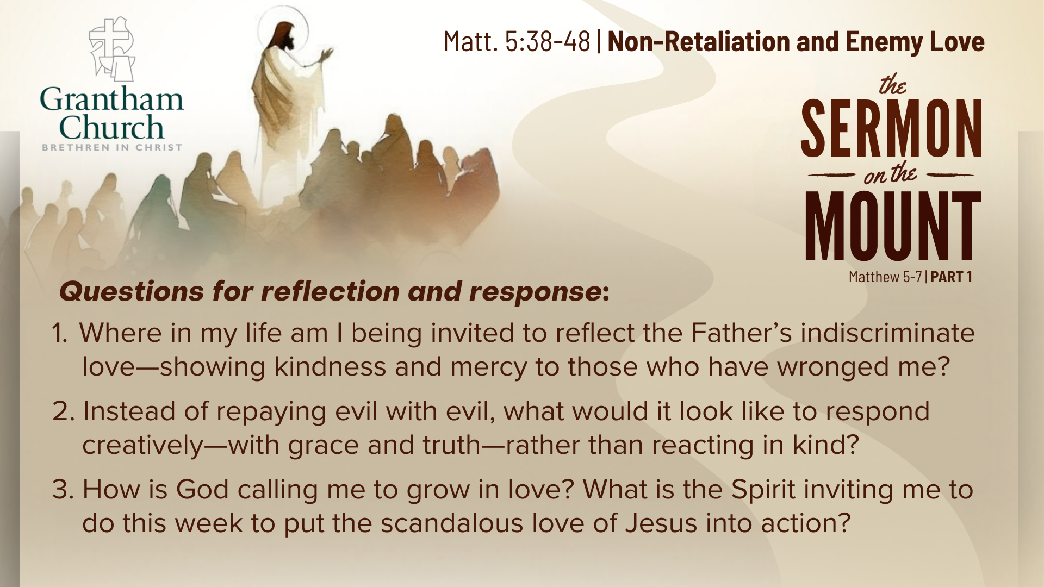
Notes:
[READ & BRIEF COMMENT ON EACH QUESTION]
Where in my life am I being invited to reflect the Father’s indiscriminate love—showing kindness and mercy to those who have wronged me?
Instead of repaying evil with evil, what would it look like to respond creatively—with grace and truth—rather than reacting in kind?
How is God calling me to grow in love? What is the Spirit inviting me to do this week to put the scandalous love of Jesus into action?
Let’s pray… [NEXT SLIDE FOR CLOSING PRAYER]

Slide 22

Notes:
Gracious Father, you have shown us what perfect love looks like—love that turns the other cheek, walks the extra mile, and welcomes even those who oppose us. We confess that we often cling to our rights, return hurt for hurt and limit our mercy. Yet you, O Lord, make your sun rise on the evil and the good. You bless those who curse you and forgive those who fail you. Shape our hearts to mirror yours. Teach us the way of your Son—the narrow way of grace, courage, and peace. When we are wronged, help us to respond as Jesus would. When we are weary, remind us that your Spirit empowers love beyond our strength. Make us your children in truth and in deed, that the world may see your kindness through us. In the name of Jesus, our Teacher and Lord, we pray. Amen.
[APOSTLES’ CREED & COMMUNION]
Benediction
Brothers and sisters, you have heard the words of Jesus and the call to follow him. The path is narrow, but it leads to life. Remember that Christ walks with you, the Father surrounds you, and the Spirit empowers you. Therefore, go in peace, to love and serve the Lord. Amen.

